Slide 1
Bios 7xx: Deep Learning Methods for Biomedical Applications with Pytorch
Chapter 10. Image Segmentation and Registration

Slide 2
Content
1 Techniques for Image Segmentation
2 Introduction to Image Registration

Slide 3
Content
1 Techniques for Image Segmentation
2 Introduction to Image Registration

Slide 4
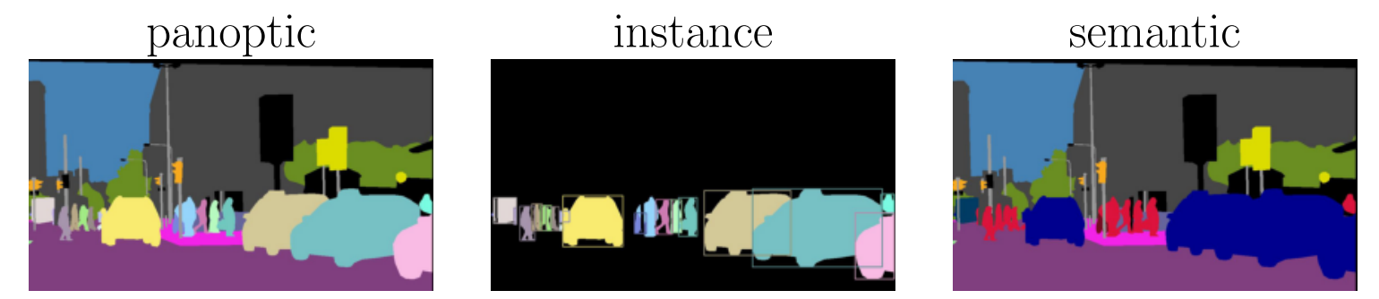
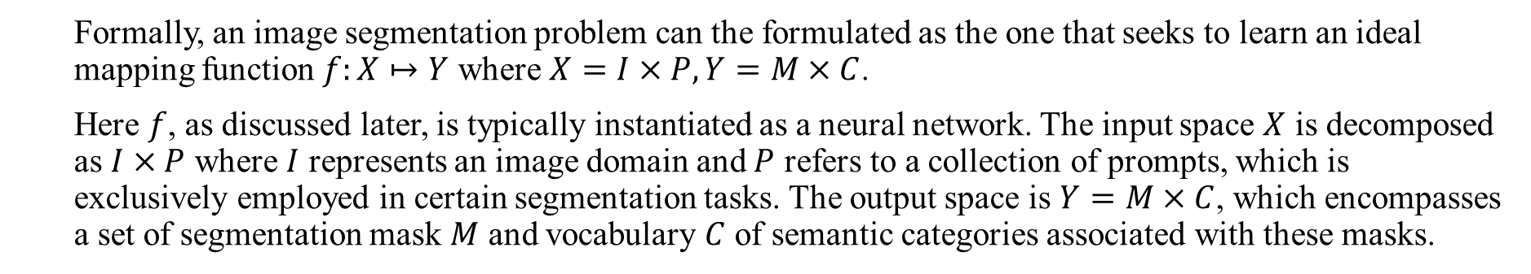
Preliminaries
Image segmentation, defined as the partition of the entire image into a set of regions, aims to make anatomical or pathological structures changes more clear in images. Image segmentation tasks can be classified into three categories: semantic segmentation, instance segmentation and panoptic segmentation.
Semantic segmentation is a pixel-level classification that assigns corresponding categories to all the pixels in an image.
Instance segmentation needs to identify different objects within the same category.
Panoptic segmentation presents a unified image segmentation approach where each pixel in a scene is assigned a semantic label and a unique instance identifier.
Formally, an image segmentation problem can the formulated as the one that seeks to learn an ideal mapping function $f:X↦Y$ where $X=I×P,Y=M×C$.
Here $f$, as discussed later, is typically instantiated as a neural network. The input space $X$ is decomposed as $I×P$ where $I$ represents an image domain and $P$ refers to a collection of prompts, which is exclusively employed in certain segmentation tasks. The output space is $Y=M×C$, which encompasses a set of segmentation mask $M$ and vocabulary $C$ of semantic categories associated with these masks.
Notes:
In fact, there are few reports on other two types of segmentation in medical image segmentation as each organ or tissue is quite different.

Slide 5
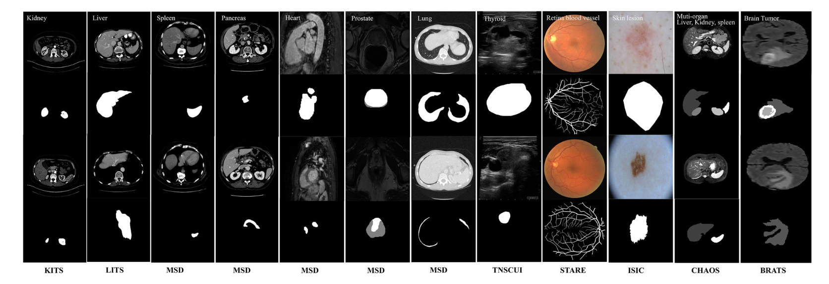
Preliminaries
In biomedical field, image segmentation often plays a key role in computer-aided diagnosis and smart medicine. The main obstacle in medical imaging segmentation lies in the fact that accessing a large amount of annotated data is nearly impossible due to privacy concerns, the complexity of the annotation process, the requirement for expert skills, and the high cost of capturing images.
Some images of benchmark datasets

Slide 6
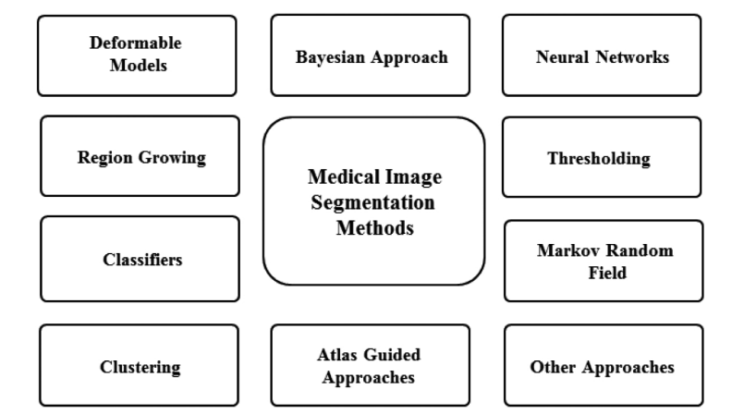
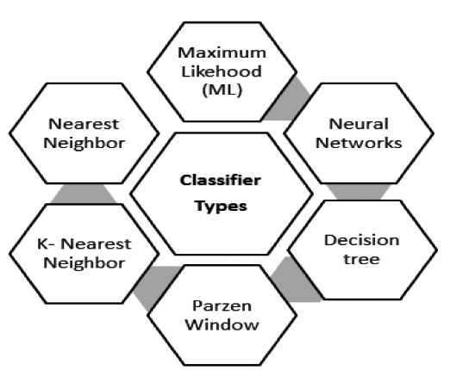
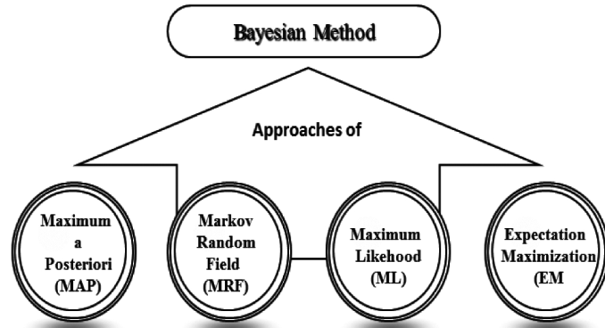
Image Segmentation before Deep Learning
Prior to the widespread application of deep learning, researchers had presented many approaches based on model-driven on medical image segmentation, including image clustering, region growing and random forest. Recently, however, there are only a few studies based on such model-driven techniques, with more and more studies based on deep learning approaches.

Slide 7
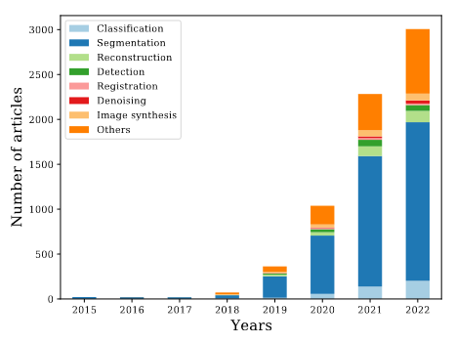
U-Net: Motivation
The general CNN networks encounter a variety of problems, as medical image segmentation, usually contain noise and show blurred boundaries. Therefore, it is very difficult to detect or recognize objects in medical images only depending on image low-level features. Meanwhile, it is also impossible to obtain accurate boundaries depending only on image semantic features due to the lack of image detail information.
To achieve image semantic segmentation, researchers have proposed a number of encoder-decoder structures that is one of the most popular end-to-end architectures. The most prominent one is U-Net.
Notes:
The figure illustrates the number of research works published in the past decade using the U-Net model as their baseline to address various medical image analysis challenges.

Slide 8
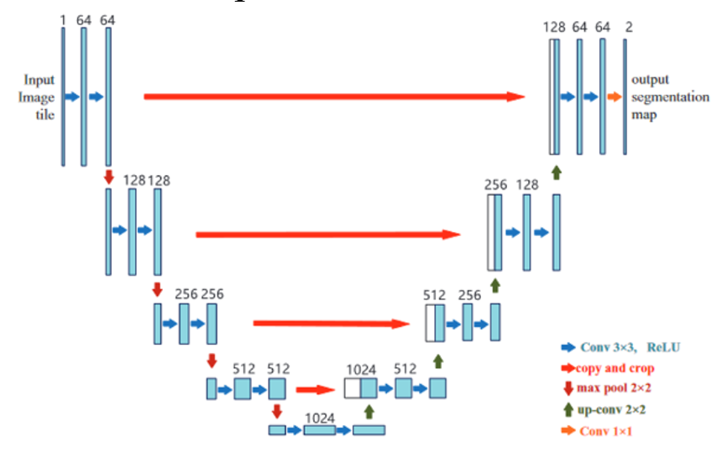
Vanilla U-Net
U-Net solves such problems through the following architectures:
Adopts a perfect symmetric structure and skip connection
Decoder recover the missing spatial information and fuse low-level and high-level mage features, which receives semantic information from bottom of encoder and recombines it with higher resolution feature maps directly obtained from encoder through skip connections
Bottleneck is used to force the model to learn a compressed representation of input such that it should only contain important and useful information for decoder.
Currently, the U-Net has become the benchmark for most medical image segmentation tasks and has inspired a lot of meaningful improvements.
Notes:
The model architecture can be divided into two parts:
The first part is the contracting path, also known as the encoder path, where its purpose is to capture contextual information. This path consists of repeated blocks, where each block contains two successive 3 × 3 convolutions, followed by a ReLU activation function and max-pooling layers. The max pooling layer is also included to gradually increase the receptive field of the network without imposing an additional computational burden.
The second part is expanding the path, also called the decoder path, where it aims to gradually up-sample feature maps to the desired resolution. This path consists of one 2 × 2 transposed convolution layer (up-sampling), followed by two consecutive 3 × 3 convolutions and a ReLU activation. The connection path between encoder and decoder paths (also known as a bottleneck) includes two successive 3×3 convolutions followed by a ReLU activation

Slide 9
3D U-Net
3D U-Net:
In practice, as most of medical data such as CT and MRI images exist in the form of 3D volume data, the use of 3D convolution kernels can better mine the high-dimensional spatial correlation of data. 3D U-Net can overcome the time-consuming slice-by-slice annotation process.
However, due to limitation of computation resources, it only includes three down-sampling (compared with four in 2D U-Net), thus cannot effectively extract deep-layer image features, leading to limited segmentation accuracy.
Cascade of 2D and 3D U-Net: Their are mainly three types of such framework
Coarse-fine segmentation: First 2D U-Net performs coarse segmentation, and then uses another 2D one to achieve fine segmentation
Detection segmentation: First model is used to extract region of interest(ROI), and then use another one for further detailed segmentation
Mixed segmentation: Hybrid cascading 2D and 3D networks, thus improving segmentation accuracy

Slide 10
Improving U-Net
According to the rapid developments in U-Net and its variants, a high-level summary of highly cited U-Net variants mainly include the following categories:
Backbone design enhancements
Skip connection enhancements
Bottleneck enhancements
Transformers
Rich representation enhancements
Probabilistic design

Slide 11
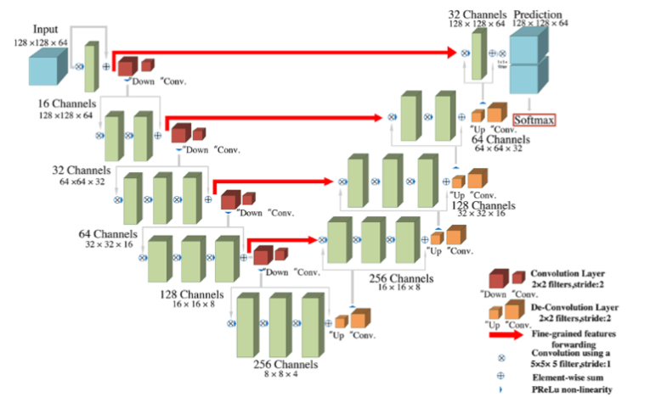
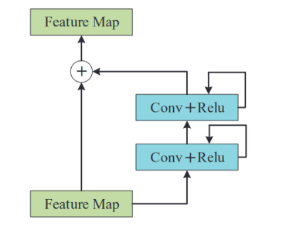
Residual Connection
V-Net
Residual connection can:
Avoid the problem of vanishing gradient, and thus enable use to deepen the network
Accelerate network convergence
Contain enough context information and provides multi-scale full resolution features
Notes:
VNet employes residual connection to design a deeper network (4 down-sampling) compared with 3D U-Net and thus obtain a higher performance.

Slide 12
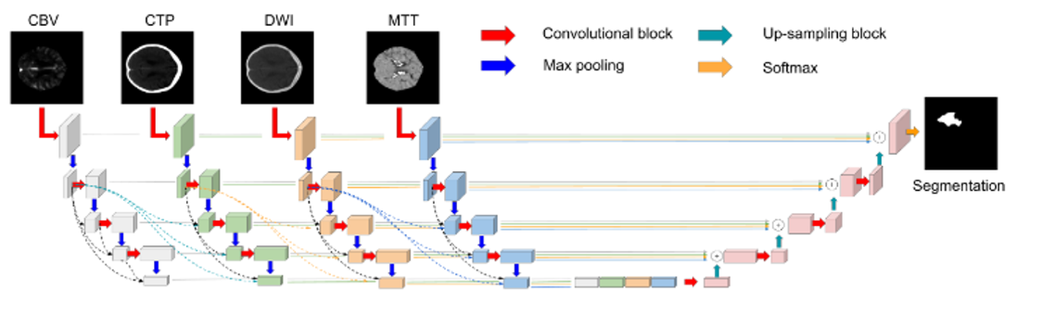
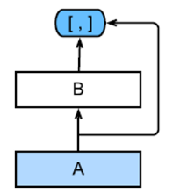
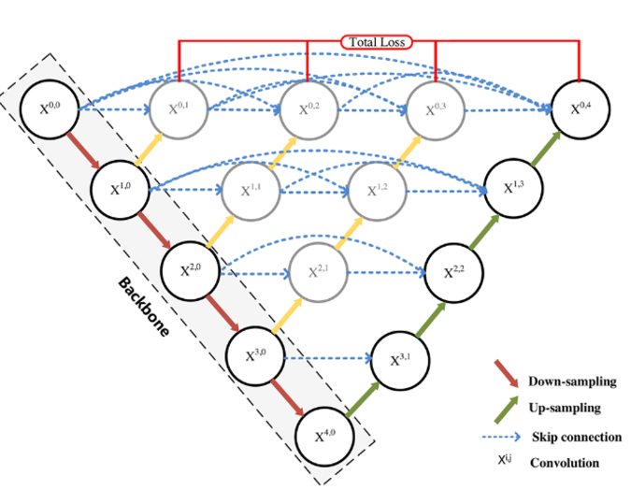
Dense Connection
HyperDenseNet
U-Net++ Skip connection enhancement: Increasing number of skip connections
Dense connection: Input of each layer comes from output of all previous layers.
Can reduce amount of parameters and also alleviate gradient vanishing problem
While dense connection is helpful for obtaining richer features, it often reduces robustness of feature representation and increase number of parameters
Notes:
UNet++ connect all UNet layers together and redesign skip connection, thus: Skip connection enhancement: Increasing number of skip connections
allowing network to learn anatomically importance of features at different levels
features with different semantic scales can be aggregated, resulting in a highly flexible feature fusion scheme
However, # of parameters also increase dramatically and pruning is neeeded, which might lead to decline in segmentation accuracy.
HyperDenseNet: Multi-modality Fusion
Each stream receives inputs of image data of modality, and layers in same and different paths are densely connected
Integrates the outputs among different paths based on densely-connected network to obtain richer feature representation from combined modalities, thus enabling the network to first extract deep intra-slice features and then learn inter-slice features with a lower computational burden

Slide 13
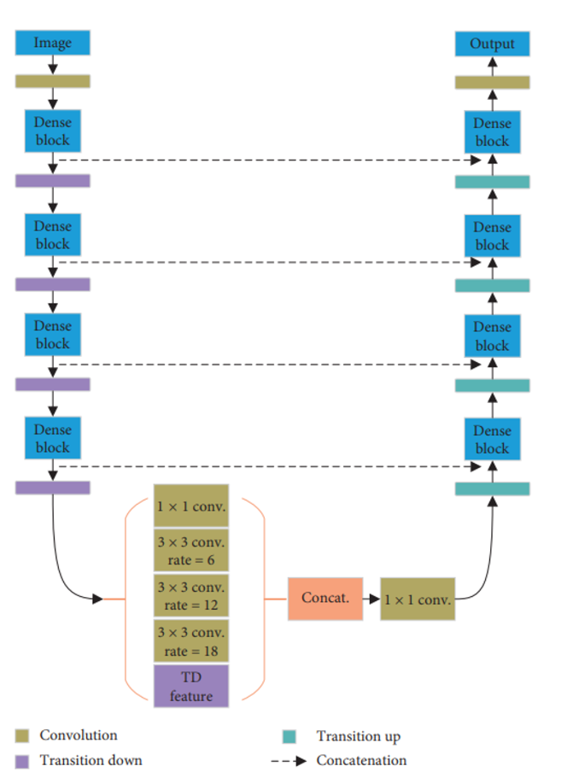
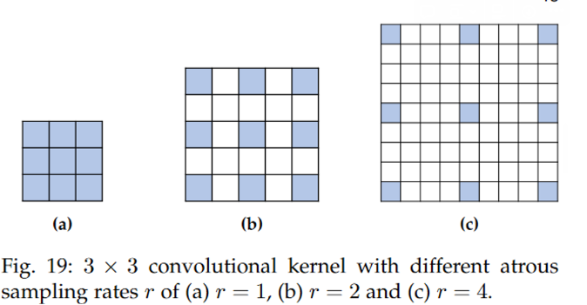
Dilation (Atrous convolutions)
Atrous Spatial Pyramid Pooling(ASPP) Bottleneck enhancement
The atrous convolutions are performed like standard convolutions, but with convolutional kernels with inserted holes in them.
It can alleviate the loss of feature information caused by pooling operation in down-sampling and up-sampling, also enlarges the receptive field size. However, it suffers from the loss of local information.
Notes:
ASPP-DenseNet Use atrous spatial pyramid pooling(ASPP) in the bottleneck. The feature maps are passed in parallel through a 1*1 convolutional layer and 3 atrous 3*3 convolutional layers, with rate 6, 12, 18 respectively.

Slide 14
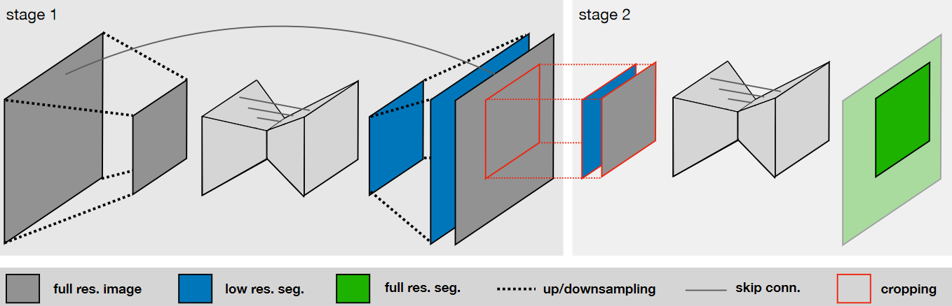
nnU-Net: Robust and Self-Adapting Framework
Thoroughly define following steps:
Preprocessing: cropping, resampling, normalization
Training: combination of dice and CE loss; data augmentation (rotation, scaling, deformation)
Inference
Potential post-processing: connected component analysis
Create several configurations for each dataset and automatically adjust all hyperparameters according to the properties of the given dataset without manual intervention.
2D U-Net
3D U-Net
3D U-Net cascade where the first one operates on low resolution images and then a high-resolution U-Net refines the predictions of the former (for 3D datasets with large image sizes only)
nnU-Net: 3D U-Net Cascade
Notes:
In practical applications, the improvements of network structure design usually depend on experience without acdequate interpretability theory support. Moreover, more complex networks models indicate higher risk of overfitting. nnU-Net havs pretty good performance, without using fancy enhancements.

Slide 15
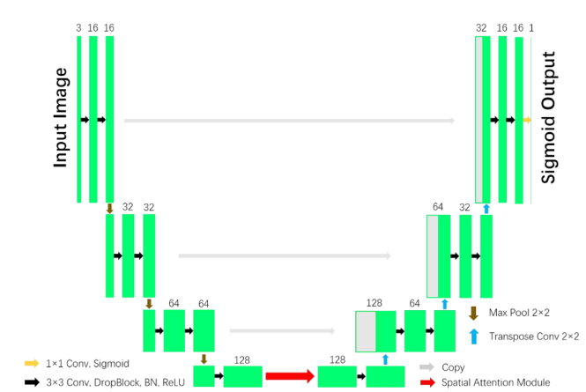
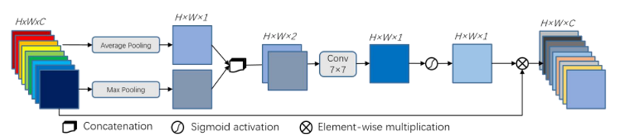
Attention Mechanism in U-Net
For neural networks, an attention block can selectively change input or assign different weights to input variables according to different importance
Spatial Attention:
Calculate feature importance of each pixel and extract key information
However, spatial attention ignores the difference of different channel information and treat each channel equally
SA-UNet Bottleneck enhancement
Notes:
SA-Unet:
Add spatial attention module to bottleneck, enhancing relevant features and compress unimportant features in the bottleneck Apply average pooling and max pooling to input feature maps in parallel. The output is then passed through a 7*7 convolutional layer and sigmoid activation to obtain a spatial attention map.

Slide 16
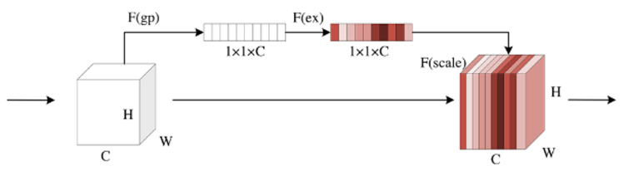
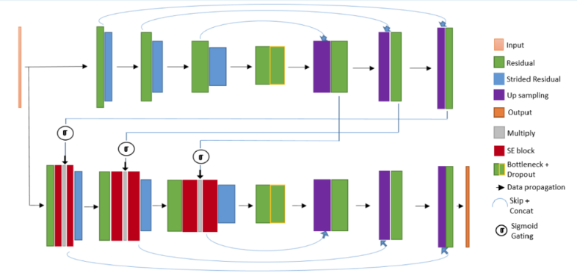
Attention Mechanism in U-Net
Squeeze-and-excitation(SE)-Net
Channel Attention:
Can achieve feature recalibration, which utilizes learned features and suppress useless features
However, channel attention pools global information directly while ignoring local information in each channel
Mixed Attention: combined spatial attention and channel attention
FocusNet
Notes:
SE-Net:
Squeezing operation: global average pooling is performed on input features to obtain $1×1×C$ feature maps
Excitation operation: channel features are interacted to reduce number of channels, the reduced features are then reconstructed back to the number of channels
The sigmoid function is employed to generate feature weight map of $[0,1]$ that multipliers the scale back to original input feature FocusNet:
It employs two parallel branches of information flow with one branch solely devoted to attention. SE-block is used for channel attention, similar to the SE-Net above.

Slide 17
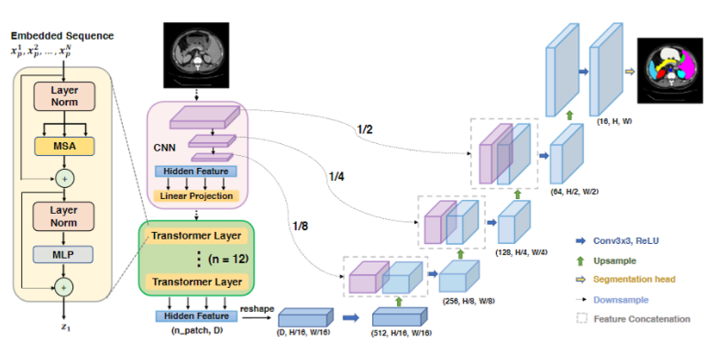
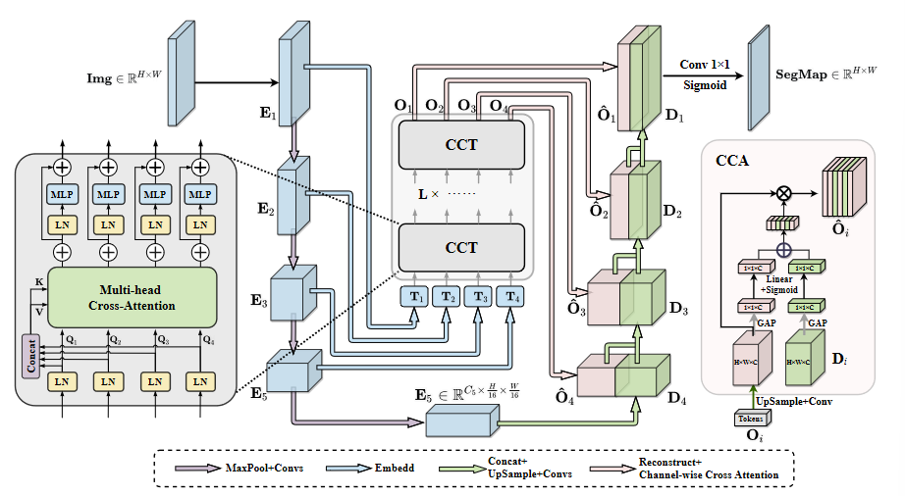
Transformer: Complement to U-Net
Utilize Vision Transformer (ViT) pre-trained on large-scale datasets in U-Net to compensate disability in long-range modeling dependencies.
The hybrid structure of CNN and Transformer makes it better to extract global information compared with pure transformer.
UC-TransNet
Skip connection enhancement: Replace original skip connections with CTrans Module
TransU-Net
Notes:
TransUnet is one of the first studies that utilized the ViT in the U-Net structure.
Encoder path: Stacked transformers are fed to extract global contexts based on primal input
Decoder path: Upsample encoded features and combine with high-resolution CNN feature maps to enable precise localization
Note that native Transformer is not fit in decoder for downstream tasks, as its 1D functionality for capturing interaction of information
UCTransNet aims to deal with the problem that the preliminary U-Net skip connections suffer from highly semantic gaps such as the ones among multi-scale encoder features and the one between encode-decoder stages. They proposed Channel Transformer (Ctrans) module that is a modification of skip connections and consists of two sub-counterparts Channel Cross Fusion with Transformer (CCT) and Channel-Wise Cross Attention (CCA) for aggregating multi-scale features adaptively and guiding the fused multi-scale channel-wise features to decoder respectively.

Slide 18
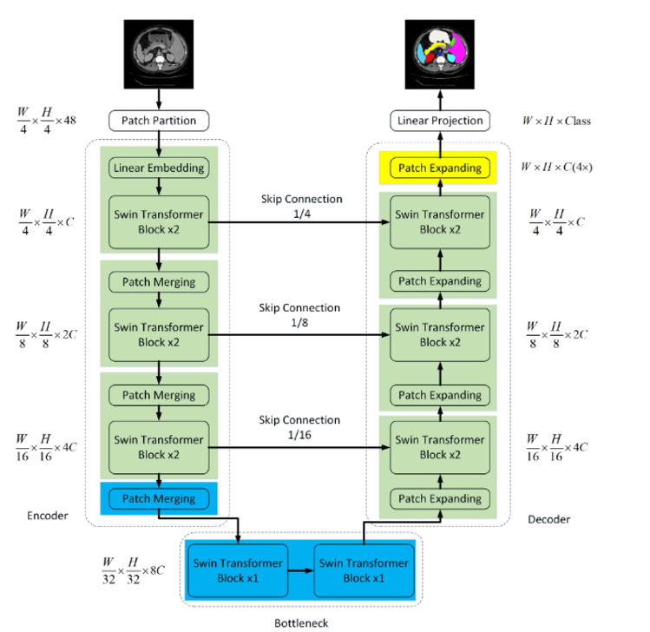
Transformer: Stand Alone Design
Main problem: Lack of data is a considerable corner point in learning positional encoding as one of the preliminary steps of Transformers.
Shifted Windows (Swin) Transformer: Shifted windowing scheme brings greater efficiency by limiting self-attention computation to non-overlapping local windows while also allowing for cross-window connection, so that the computational complexity can be linear instead of quadratic.
Swin-U-Net
Notes:
Swin-UNet, which is a UNet-like pure Transformer for medical image segmentation, using Swin Transformer block as the main counterpart of U-Shaped network. The tokenized image patches are fed into the Transformer-based U-shaped Encoder-Decoder architecture with skip-connections for local global semantic feature learning. Specifically, They use hierarchical Swin Transformer with shifted windows as the encoder to extract context features. A symmetric Swin Transformer-based decoder with patch expanding layer is designed to perform the up-sampling operation to restore the spatial resolution of the feature maps. This model achieves better results over TransUNet and demonstrated robust generalization ability.

Slide 19
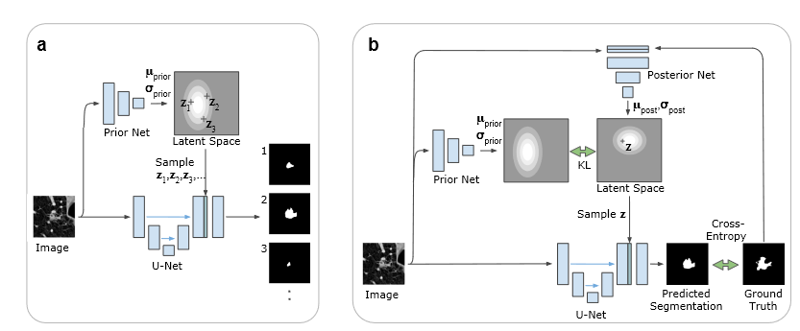
Probabilistic Design: Variational Autoencoder (VAE)
In medical image segmentation tasks, different graders often produce different segmentations, most of which are plausible as many medical images contain ambiguities that can not be resolved. One approach to take this fact into consideration is to learn a distribution over segmentations to produce an unlimited number of possible segmentations instead of just providing the most likely one.
Probablistic U-Net
Notes:
This model combined U-Net for producing reliable segmentations, with a conditional VAE in prior net, which can model complex distributions and encodes the segmentation variants in a low-dimensional latent space.
Passing the input image in through the prior net, it will determine the probability of the encoded variants. A random sample from the prior probability distribution is drawn and broadcast to have the same shape as the segmentation map.This will then be concatenated with the final feature maps of U-Net to produce the segmentation map.

Slide 20
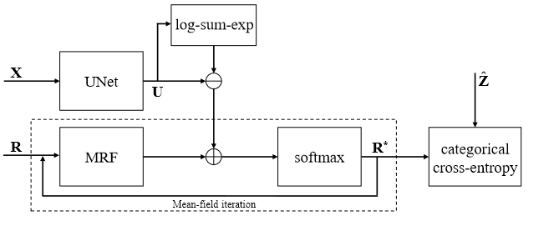
Probabilistic Design: Graphical Model Algorithm
While the classic U-Net performs well on data from the same distribution as the training data, its accuracy decreases on out-of-distribution one. To address the problem, one can combine a U-Net with Markov random fields (MRFs). The low-parameter, first-order MRFs are better at generalization because they encode simpler distributions which is an important quality to fit out of distribution data. The drawback of less flexibility of MRFs can be made up by the very accurate U-Net predictions.
MRF-UNet

Slide 21
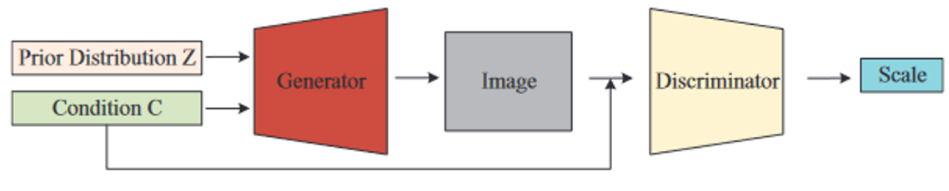
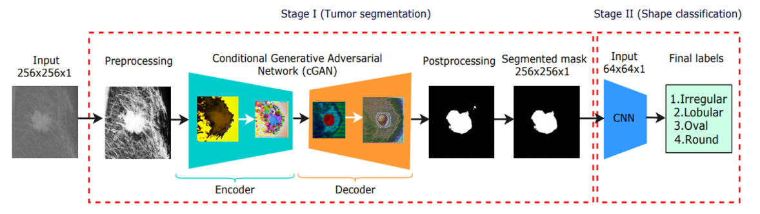
Generative Adversarial Network
GAN can not only be used in image augmentation, but also for segmentation
Generative network is used for segmentation, while adversarial network is trained as a classifier
Conditional GAN(cGAN)
Notes:
generative network learns to identify tumor regions and generates segmentation results
adversarial network learns to distinguish between ground truth and segmentation results from generative network

Slide 22
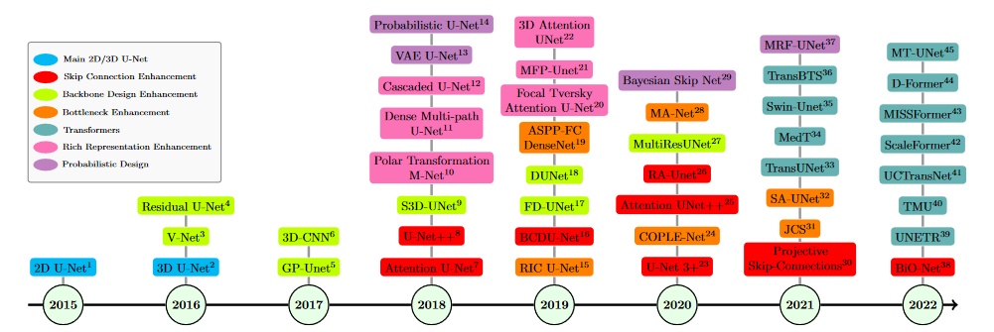
Timeline of Prominent U-Net Variants

Slide 23
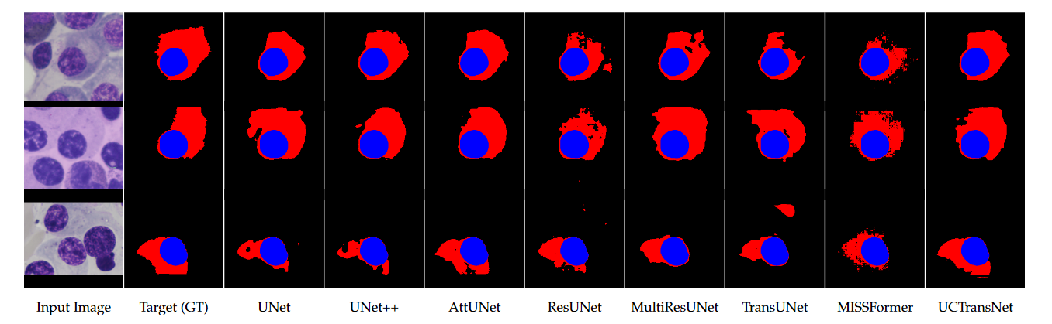
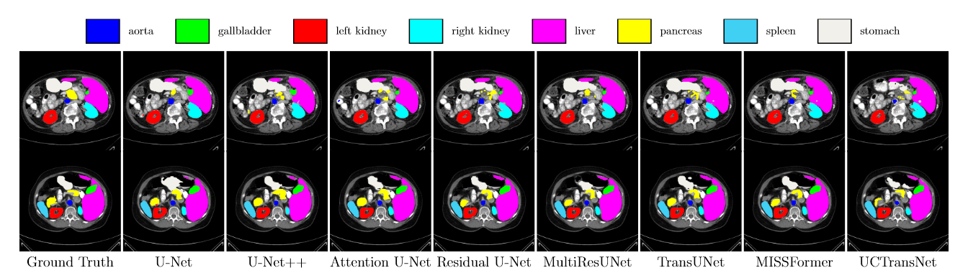
Visual Comparisons Example
SegPC2021
Synapse
Notes:
Some remarks:
The multi-scale representation power of UCTransNet shows the effectiveness in generating segmentation maps for cells with varying scales and backgrounds
As the baseline method, U-Net, although performs well in comparison with parameter numbers, suffer from several visual defects including miss-labeling, over-segmentation and under0segmentation. In this case Transformer-based methods represent better results with respect to CNN-based ones.

Slide 24
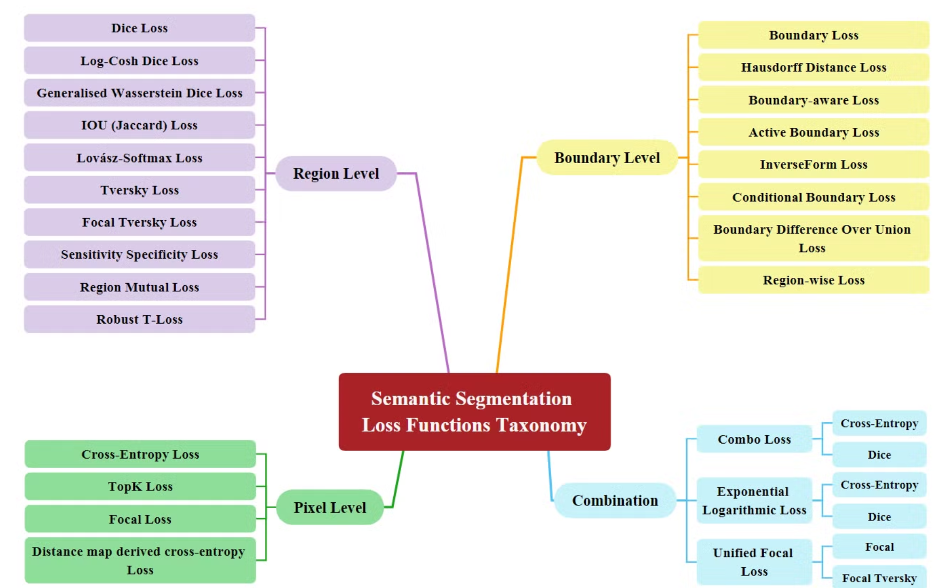
Loss Functions: Taxonomy
In addition to improved segmentation speed and accuracy by designing network backbone and function block, utilizing appropriate loss functions can also result in improvements in subsequent inference-time segmentation accuracy.

Slide 25
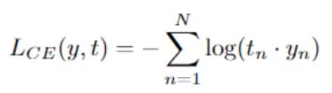
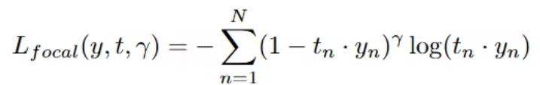
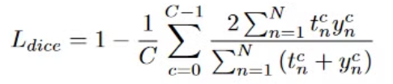
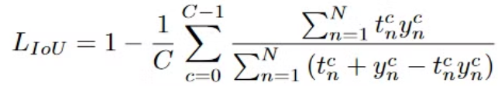
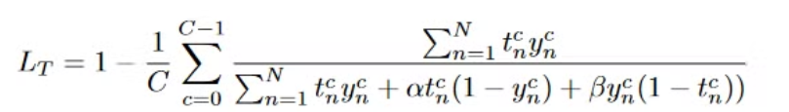
Loss Functions: Classic Ones
Pixel Level: Compute the dissimilarity between predicted values and corresponding ground true labels.
Cross-Entropy Loss: Measure the difference between two probability distributions for a given random variable, where the model generates a pixel-wise probability map y through softmax
Focal Loss: Extension of CE loss by adding a tuning term here to assign different weights to easy and hard samples (the harder the example, the higher weight it will get)
Region Level:
Dice Loss: Evaluate the overlap between a segmentation result and corresponding ground truth.
IOU(Jaccard) Loss: Similar to Dice loss, measure the intersection over union.
Tversky Loss: Control the distribution of both false positive and false negative to the loss function.
Notes:
Here $t_{n}$ is the one-hot encoding vector representing the target class of the n-th pixel. $y_{n}$ is the predicted class probabilities for the n-th pixel. $t_{n}⋅y_{n}$ is the predicted probability for the target class.

Slide 26
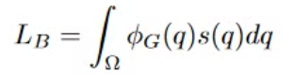
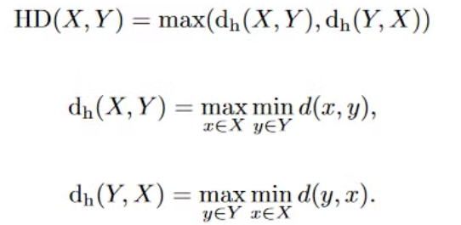
Loss Functions: Classic Ones
Boundary Level: Emphasizes the precision of boundaries.
Boundary Loss: Aim to solve the imbalance between the size of foreground region and background region.
Hausdorff distance(HD) Loss:
Combination: One can also combine loss functions from distinct categories to offer versatility and adaptability.
For instance, the combination of Dice loss and boundary loss is superior to the single one.
Notes:
For the boundary loss $s(q)$ is the probability predictions generated by the model and $Φ_{G}(q)$ is the distance term.

Slide 27
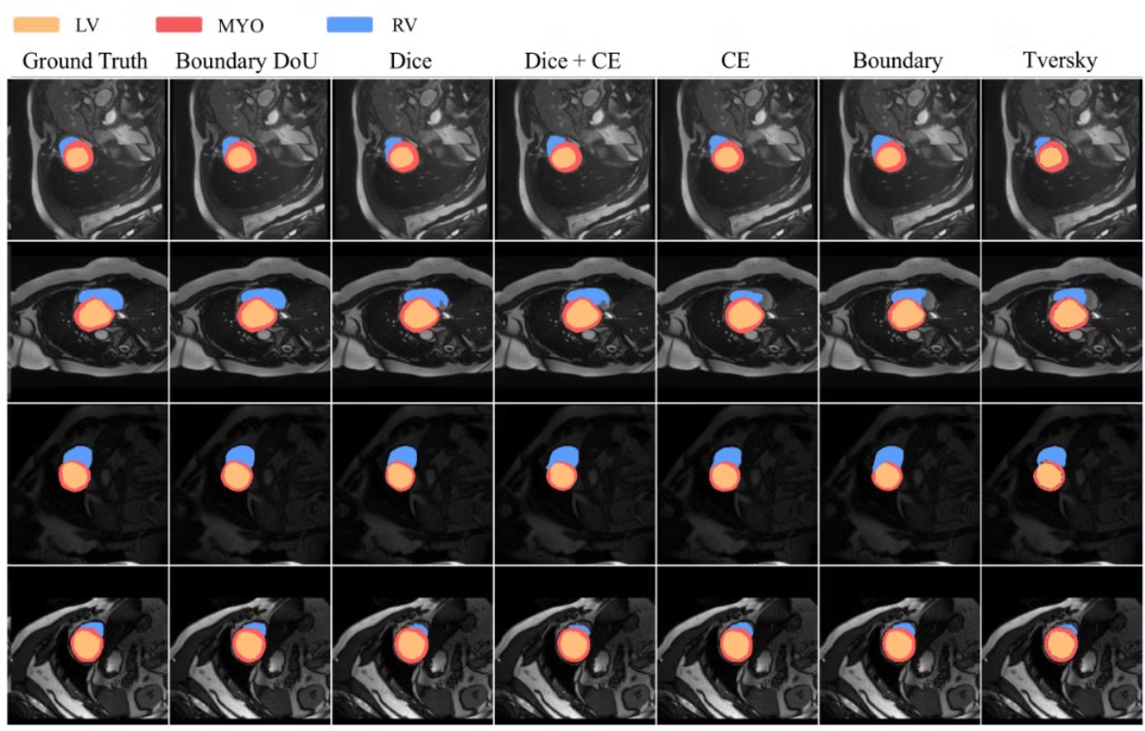
Loss Functions: Visual Comparison
Notes:
If we use boundary-level loss, than we can have more accurate localization of boundary regions, especially for object with significant shape variation (right ventricle in this case) or highly detailed regions

Slide 28
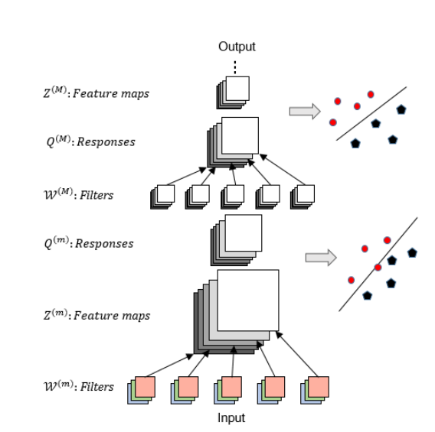
Deep Supervision
In order to train deep networks effectively, one can add some auxiliary branching classifiers to some layers of the neural network, thus eliminating redundant computation and reducing the risk of over-fitting in the case of limited training data.
Deeply-Supervised Nets

Slide 29
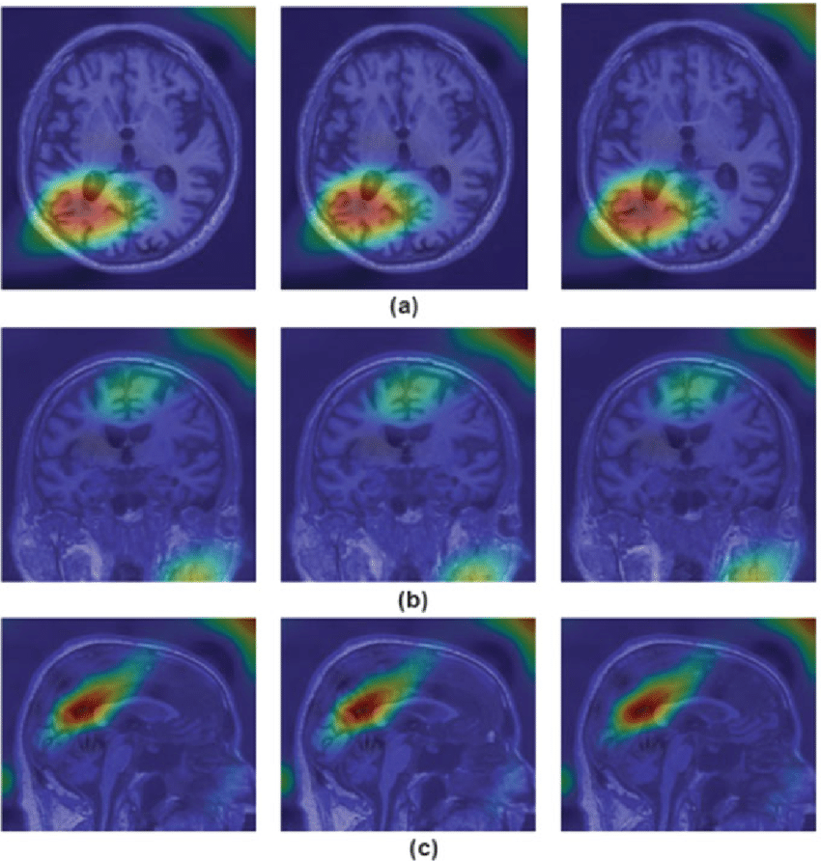
Interpretability
Medical image analysis is an aid to the clinical diagnosis, the clinicians wonder not only where the lesion is located at, but also the interpretability of results given by networks. Currently, the interpretation of medical image analysis is dominated by visualizations such as attention and the class-activation-map(CAM).

Slide 30
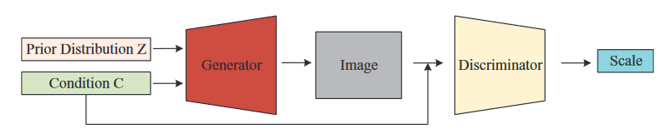
Data Augmentation
Traditional Methods: General data augmentation methods include the improvement of image quality such as noise suppression, the change of image intensity such as brightness, saturation and contrast; as well as the change of image layout such as rotation, distortion and scaling.
Conditional Generative Adversarial Nets (cGAN): Adds a condition to the original GAN in order to guide the generation process so that the generated pictures are not random.

Slide 31
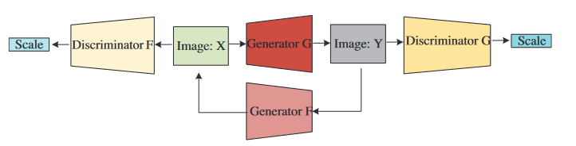
Transfer Learning
Transfer learning can achieve fast model training for data with limited labels.
Pre-trained Models: Using pre-trained networks on natural images such as ImageNet and then perform fine-tuning on medical data can further improve the segmentation effect of medical images.
Domain Adaption: If the labels from the training target domain are not available, and one can only access the labels in other domain, then one popular method is to transfer the trained classifier on the source domain to the target domain without labelled data.
Notes:
We can achieve domain adaption through CycleGAN which consists of two generators and two discriminators. First, an image in X domain is transferred to Y domain by an generator G. Then the output from G is reconstructed back to the original image by generator F. Both discriminators G and F play discriminating roles ensuring the style transfer of images. Through cycle consistency loss, the network ensures that the image can be reconstructed after translating it between the two domains.

Slide 32
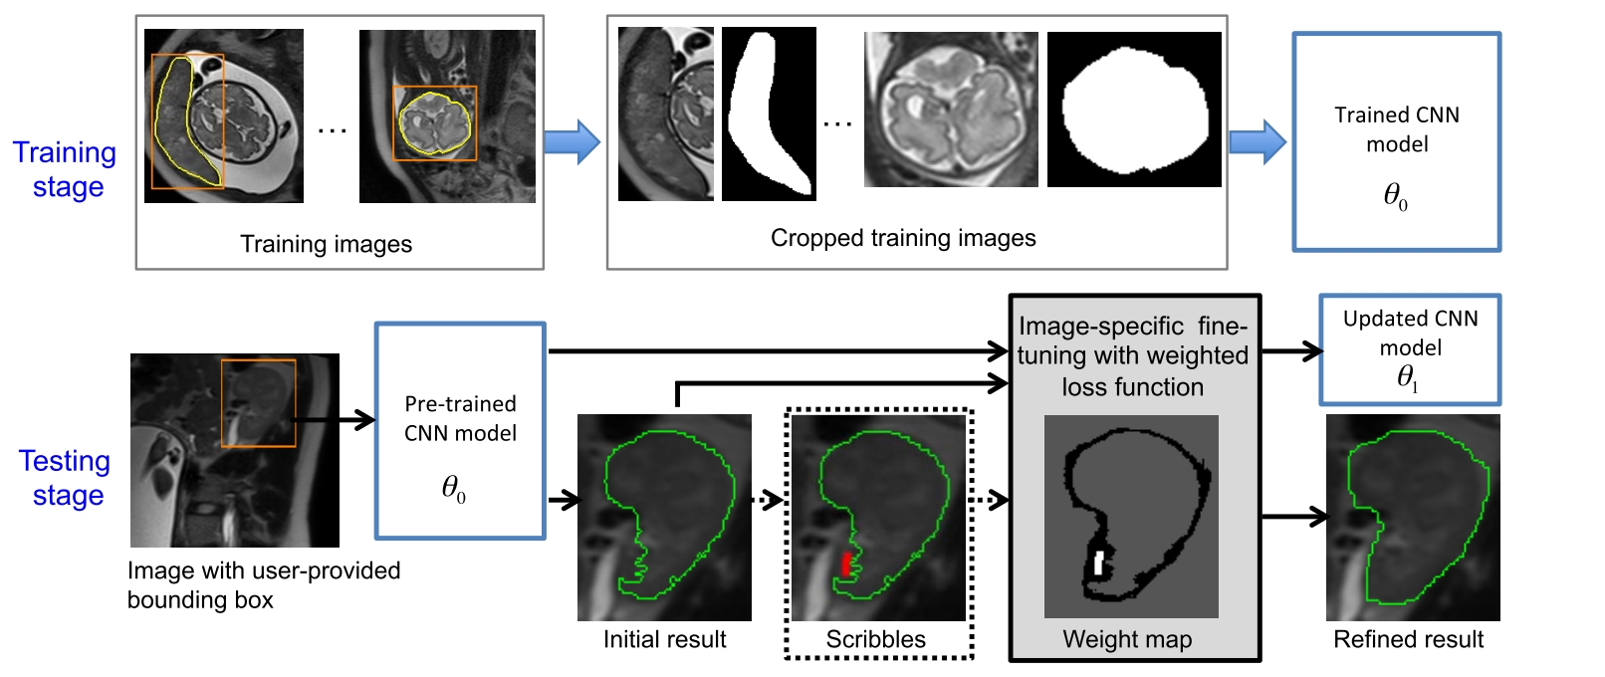
Interactive Segmentation
Manually drawing medical image segmentation labels is usually tedious and time-consuming, especially for the drawing of 3D volume data. Interactive segmentation allows clinicians to correct interactively the initially segmented image generated by a model to obtain more accurate segmentation. Such interactive methods include mouse clicks and outline boxes.
BIFSeg
Notes:
BIFSeg: Users first draw a bounding box, and the area inside the bounding box is considered as the input of CNN, then an initial result is obtained. After that, users perform an image-specific fine-tuning to make CNN provide better segmentation results.

Slide 33
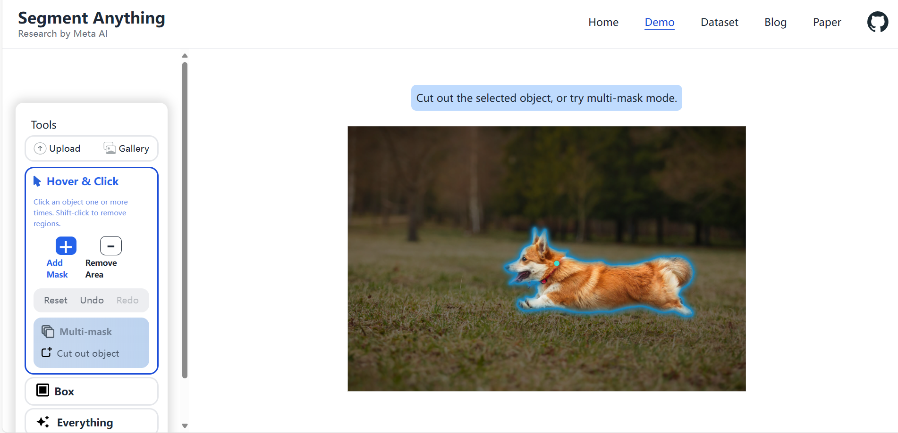
Play Around: Segment Anything
Segment Anything | Meta AI (segment-anything.com)

Slide 34
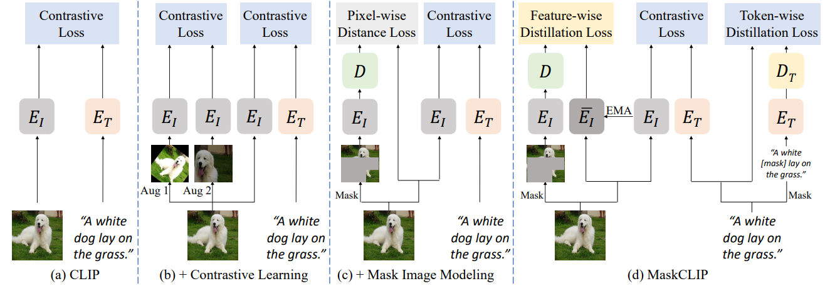
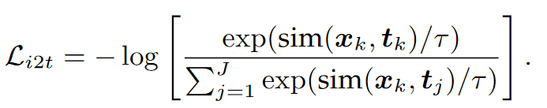
Foundation Model for Image Segmentation
Foundation Models (FMs) are initially elucidated as “any model that is trained on broad data that can be adapted to a wide range of downstream tasks”. The word “foundation” emphasizes that the character of FM is homogenization of the methodologies across research communities and emergence of new capabilities.
Vision FMs include
Contrastive Language-Image Pre-Training (CLIP): Embodies a language-supervised vision model trained on 400M image-text pairs sourced from the Internet. The model has an encoder-only architecture, and is trained by an image-text contrastive learning objective that maximize the agreement between the embeddings of matching image and text pairs.
Diffusion Models (DMs): A family of generative models that are Markov chains trained with variational inference. It has set the current state-of-the-art in generation tasks.
MaskCLIP
Notes:
MaskCLIP finds that it is feasible to extract segmentation knowledge from CLIP with minimal modifications to the attention pooling module.

Slide 35
Content
1 Techniques for Image Segmentation
2 Introduction to Image Registration

Slide 36
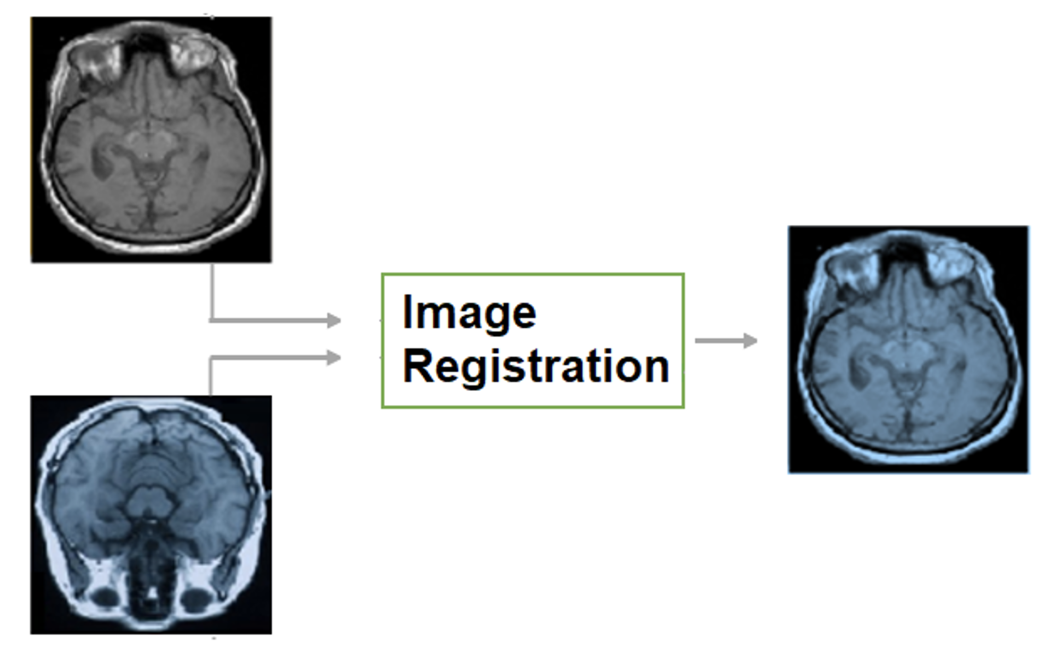
Image Registration: Overview
Medical image registration involves estimating the optimal spatial transformation to align the structures of interest in a pair of fixed and moving images.
The choice of spatial transformation, depending on the specific application, can be categorized as either rigid/affine or non-rigid/deformable.
In rigid/affine registration, all spatial coordinates are transformed using the same rigid/affine matrix.
On the other hand, non-rigid/deformable registration employs independent transformation for local regions or spatial coordinates.
Both types of registration are of great importance to many medical imaging tasks:
Rigid registration is commonly used when the rigid body assumption holds. For example, it is used to align a structural scan such as MRI or CT with a functional scan such as fMRI or PET of the same patient for attenuation correction or interpretation of functional activities.
On the other hand, deformable image registration (DIR) is often used in cases where more complex, spatially varying deformations are needed. Examples of such applications include constructing deformable templates for a patient cohort or registering atlases to a patient image for multi-atlas segmentation.
Notes:
For the figure, left column is source, middle column is target and right column is the warped source.

Slide 37
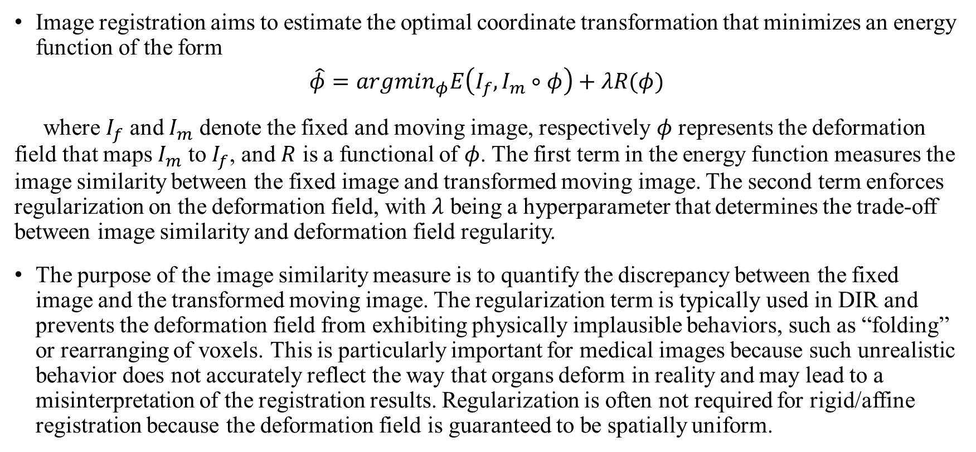
Fundamental of Image Registration
Image registration aims to estimate the optimal coordinate transformation that minimizes an energy function of the form
$$\hat{φ}=argmin_{φ}E\left(I_{f},I_{m}∘φ\right)+λR(φ)$$
where $I_{f}$ and $I_{m}$ denote the fixed and moving image, respectively $φ$ represents the deformation field that maps $I_{m}$ to $I_{f}$, and $R$ is a functional of $φ$. The first term in the energy function measures the image similarity between the fixed image and transformed moving image. The second term enforces regularization on the deformation field, with $λ$ being a hyperparameter that determines the trade-off between image similarity and deformation field regularity.
The purpose of the image similarity measure is to quantify the discrepancy between the fixed image and the transformed moving image. The regularization term is typically used in DIR and prevents the deformation field from exhibiting physically implausible behaviors, such as “folding” or rearranging of voxels. This is particularly important for medical images because such unrealistic behavior does not accurately reflect the way that organs deform in reality and may lead to a misinterpretation of the registration results. Regularization is often not required for rigid/affine registration because the deformation field is guaranteed to be spatially uniform.

Slide 38
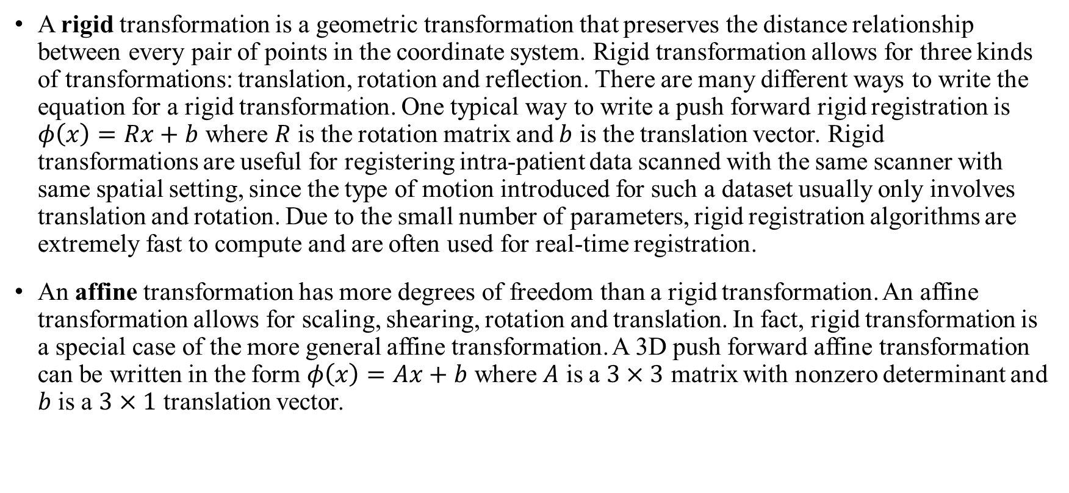
Rigid/Affine Transformation Model
A rigid transformation is a geometric transformation that preserves the distance relationship between every pair of points in the coordinate system. Rigid transformation allows for three kinds of transformations: translation, rotation and reflection. There are many different ways to write the equation for a rigid transformation. One typical way to write a push forward rigid registration is $φ\left(x\right)=Rx+b$ where $R$ is the rotation matrix and $b$ is the translation vector. Rigid transformations are useful for registering intra-patient data scanned with the same scanner with same spatial setting, since the type of motion introduced for such a dataset usually only involves translation and rotation. Due to the small number of parameters, rigid registration algorithms are extremely fast to compute and are often used for real-time registration.
An affine transformation has more degrees of freedom than a rigid transformation. An affine transformation allows for scaling, shearing, rotation and translation. In fact, rigid transformation is a special case of the more general affine transformation. A 3D push forward affine transformation can be written in the form $φ\left(x\right)=Ax+b$ where $A$ is a $3×3$ matrix with nonzero determinant and $b$ is a $3×1$ translation vector.

Slide 39



Polynomial and B-Splines Model
Automatic Image Registration (AIR) brough several novel contributions such as the usage of high order polynomials. Registration is performed in multiple resolutions from lowest to highest details using polynomials of increasing degree. Specifically, an $N$-th order polynomial pullback transformation $h:R^{3}→R^{3}$ is defined as $h\left(y\right)=\sum_{0≤\left|α\right|≤N}{\left[\begin{aligned}p_{α} \\ q_{α} \\ r_{α}\end{aligned}\right]y^{α}}$ where $p_{α},q_{α},r_{α}∈R$. The degree of freedom of an $N$-th order polynomial $p$ in $m$ dimensional space is $dof\left(p\right)=m\left(\begin{aligned}m+N \\ m\end{aligned}\right)$.
FLIRT is a registration tools of the FSL. It is a rigid and linear registration methods which works on 2D to 3D images. FNIRT, on the other hand, is a deformable registration method using cubic splines.

Slide 40



Time-dependent Velocity Field Transformation Model
The most general form of a small deformation transformation is a vector field transformation model, i.e., a transformation that is parameterized by a displacement vector at each voxel location. A vector field has the most degrees of freedom of any transformation model. For example, a 3D transformation of a ${256}^{3}$ voxel image has $3×{356}^{3}≈5×{10}^{9}$ parameters. As a result, the regularization is a must in such algorithms.
Large deformation transformation models are defined as transformations that have locally large rotation and locally large strains. Such models can accommodate registration problems that require either large or small deformations, but are not necessarily the correct choice for small deformation applications.
One specific approach of large deformation transformation model called Large Deformation Diffeomorphic Metric Mapping(LDDMM) is through modeling a flow of diffeomorphisms. In this approach, the diffeomorphic (smooth and invertible) transformation that registers image $I_{1}$ to $I_{2}$ is estimated as the end-point of the flow associated to a smooth time-dependent vector field. Let $v:\left[0,1\right]→V$ be a time-dependent velocity vector field, then the velocity vector field $v$ defines a flow of diffeomorphisms $φ^{v}:\left[0,1\right]→G$ as the solution of the ODE $\frac{d}{dt}φ_{t}^{v}\left(x\right)=v_{t}(φ_{t}^{v}\left(x\right))$ where $G$ is the set of diffeomorphisms on $Ω$ and superscript in $φ^{v}$ denotes the dependence of $φ$ on $v$. The initial condition at $t=0$ is that $φ_{0}^{v}$ is the identity transformation. The end point of the flow at time $t=1$ is the desired diffeomorphism. Thus the goal of the model is to find a time-dependent velocity vector field $v$ that generates the diffeomorphism when integrated.
Symmetric Image Normalization Method (SyN) used in Advanced Normalization Tools(ANTs) platform employs LDDMM in two symmetric components. Instead of having a target image, the transformation computation consists in applying the forward and backward transformation to each image until their contents match.
Notes:
Diffeomorphic image registration is highly desirable because it provides transformation invertibility and topological preservation. Formally, it is defined as smooth and continiuous one-to-one mappings with smooth and continuous inverse.

Slide 41

Stationary Velocity Field Transformation Model
A simple variation is to assume that the velocity vector field $v$ is stationary, i.e., $v$ is constant for time $0≤t≤1$. In this case, the model can be formulated as $\frac{d}{dt}φ_{t}^{v}\left(x\right)=v(φ_{t}^{v}(x))$, where the velocity field $v$ is no longer a function of time $t$. Clearly this model requires less computer storage and is more efficient, but also more limited than a diffeomorphism produced by a time varying velocity field.
Mutual Information Demons and Diffeomorphic Demons are grounded on the classical Demons paper, which models the registration problems as the demon of Maxwell which separated molecules of gases into two chambers. This Demons algorithm makes use of such large deformation stationary velocity field transformation model. The diffeomorphic version constrained the high deformation of the original method and mutual information version allowed multi-modality registration.
Tang, Lisa, and Ghassan Hamarneh, P643
Notes:
Maxwell's demon is a thought experiment that appears to disprove the second law of thermodynamics. It was proposed by the physicist James Clerk Maxwell in 1867.[ In his first letter, Maxwell referred to the entity as a "finite being" or a "being who can play a game of skill with the molecules". Lord Kelvin would later call it a "demon".
In the thought experiment, a demon controls a door between two chambers containing gas. As individual gas molecules (or atoms) approach the door, the demon quickly opens and closes the door to allow only fast-moving molecules to pass through in one direction, and only slow-moving molecules to pass through in the other. Because the kinetic temperature of a gas depends on the velocities of its constituent molecules, the demon's actions cause one chamber to warm up and the other to cool down. This would decrease the total entropy of the system, seemingly without applying any work, thereby violating the second law of thermodynamics.
The concept of Maxwell's demon has provoked substantial debate in the philosophy of science and theoretical physics, which continues to the present day. It stimulated work on the relationship between thermodynamics and information theory. Most scientists argue that, on theoretical grounds, no practical device can violate the second law in this way. Other researchers have implemented forms of Maxwell's demon in experiments, though they all differ from the thought experiment to some extent and none has been shown to violate the second law.

Slide 42

Summary of Transformation Models
Notes:
Summary of Deformation Strength Ranking (from most constrained to most flexible):
Rigid Deformation (most constrained)
Affine Deformation
Diffeomorphic Deformation (velocity field, SyN)
B-spline Free-Form Deformation
Thin-Plate Spline Deformation
Elastic Deformation (most flexible)

Slide 43
Drawbacks of Traditional Image Registration
Traditionally, image registration such as Demons and SyN has been accomplished by iteratively solving an optimization problem. These methods are well-established and supported by strong mathematical theory. However, they come with notable limitations:
They are computationally intensive and tend to be slow, as they involve solving a distinct optimization problem for every pair of moving and fixed images, leading to redundancy across optimizations.
The objective function related to transformation parameters (such as displacement fields or control points) typically exhibits non-linearity, creating a non-convex optimization dilemma.

Slide 44

Learning-based Image Registration
Unlike traditional methods, deep learning-based methods train a general network by optimizing a global objective function on a training dataset. Then in the testing phase, the trained network is directly applied to each image pair with fixed network weights without further optimization.
Deep learning-based methods offer a threefold advantage:
Firstly, the diversity within the training dataset acts as an implicit regularization, effectively smoothing the loss landscape by averaging out noisy or misleading gradients that may lead to suboptimal local minima.
Secondly, the optimization of non-convex problems is highly dependent on the initial starting point. In contrast, the use of pretrained weights through transfer learning, combined with advanced optimization algorithms, enhances deep learning methods’ capacity to locate global minima.
Lastly, the capability to process image pairs through a single forward pass during inference, avoiding iterative optimization, results in a significant speed advantage over traditional optimization-based methods.
Notes:
The blue bars represent the count of papers that include keywords related to learning-based image registration in their title or abstract, while the green bars display the count of papers specifically related to unsupervised learning-based image registration

Slide 45
Learning-based Image Registration
Initially, image registration network architectures were mostly encoder-based, serving either as feature extractors to replace hand-crafted features in optimization-based registration methods.
However, following the success of U-Net in medical imaging, learning-based deformable registration methods began to incorporate an encoder-decoder architecture within a supervised learning network
On the other hand, learning-based rigid/affine registration methods continue to adopt encoder-only networks, with the output being the rigid or affine parameters.
In the context of supervised learning for these deep learning-based methods, the ground truth is typically a transformation matrix for rigid/affine registration tasks, while a dense displacement field is used for deformable registration tasks.

Slide 46



Spatial Transformer Network (STN)
Spatial Transformer Networks are a type of neural network module designed to allow models to spatially manipulate data within the network itself. The key idea behind STNs is to provide a way for the network to actively learn how to transform input data, such as scaling, rotating, or translating, in order to improve task performance (e.g., image classification). This is achieved through a differentiable mechanism that learns spatial transformations, making the entire system end-to-end trainable.
An STN consists of three key components:
Localization Network: Learns parameters $θ$ of the transformation $Γ_{θ}$ to apply. For an affine transformation, $θ$ has 6-dimensional.
Grid Generator: Creates a grid that defines how pixels in the input should be sampled.
Sampler: Applies the transformation by sampling from the input according to the grid.
By incorporating STNs, a network can become more invariant to variations in the input's spatial configuration, leading to improved robustness and generalization.
Notes:
For the bottom figure, (a) is the identity transformation and (b) is the result of warping the regular grid with an affine transformation.

Slide 47
Supervised vs. Unsupervised Learning
Learning-based registration methods can be broadly categorized as supervised and unsupervised.
Supervised registration methods use ground truth transformations as target output during the training process. Methods that employ landmark correspondences or anatomical label maps are still categorized under supervised learning.
Unsupervised methods refer to those that do not require ground truth transformations. In certain contexts, the term “unsupervised” might be misleading. A more precise term could be “self-supervised” to underscore the training aspect of deep learning.
During the early stages of development, the majority of learning-based registration methods were supervised. The ground truth transformations required for the training process are typically generated using traditional registration methods. However, generating such ground truth transformations is a time-consuming process, which is a notable drawback of such methods. In addition, since these networks are trained to mimic the function of traditional methods, their registration performance may not surpass that of the methods they are based on.
More recently, the introduction of STN has led to a shift towards developing unsupervised methods that do not rely on ground truth transformation. These methods use the difference between the deformed moving image and fixed image to update the network, enabling end-to-end training.

Slide 48

Paradigm for Learning-based Registration
Figure above illustrates the conventional paradigm of learning-based rigid/affine and DIR. Typically, these paradigms consist of the following components:
Moving and fixed images as input
A deep neural network
STN (for unsupervised methods)
A loss function
Notes:
The way in which moving and fixed images are input into deep neural networks varies depending on the architecture. They can either be concatenated and sent in as a single input, or each can be processed by the neural network, with the feature maps combined in a deeper stage.
For affine/rigid registration models, encoders are used for feature extraction and fully connected layers are used to output the parameters of the predicted transformation.
For DIR methods, deep neural networks with both encoder and decoder are used, and the result is a deformation field of equal sizes to the input images.
In the unsupervised setting, the predicted transformation is used by the spatial transformer to warp the moving image

Slide 49
Weak Supervision & Unsupervised Learning
Methods that use ground truth transformation generation were mainly supervised method for direct transformation prediction. Weakly supervised transformation prediction has also been explored. Instead of using artificially-generated transformations, higher-level correspondence information such as labels of anatomical organs are used for training. Such labels are more reliable and practical to obtain.
As for the unsupervised learning where there is no ground truth transformation to reference, regularization is usually used to enforce smoothness in the transformation.

Slide 50

Loss Functions: Classic Ones
Landmark Error: Let a pair of points $p∈Ω$ and $q∈Ω$ identify a landmark in images $I_{m},I_{f}$ respectively. Then for $N$ landmark locations, we obtain point sets $P=\{p_{1},p_{2},…,p_{N}\},Q=\{q_{1},q_{2},…,q_{N}\}$. Before the registration the Pre-registration Mean Landmark Error is measured: $MLE_{pre−registration}=\sum_{i=1}^{N}{|\left|p_{i}−q_{i}\right||}$. Afterwards, the MLE for the registered landmark set is defined as $MLE=\sum_{i=1}^{N}{|\left|φ(p_{i})−q_{i}\right||}$
ROI Overlap Evaluation: Dice $2\frac{\left|S_{i}∩T_{i}\right|}{\left|S_{i}\right|+\left|T_{i}\right|}$ and IOU(Jaccard) $\frac{\left|S_{i}∩T_{i}\right|}{|S_{i}∪T_{i}|}$ where $S_{i},T_{i}$ are the segmented region in the deformed source and target volumes.
Sum of Squared Differences: Assuming a pair of registered images differ only by Gaussian noise, registration accuracy can be evaluated by measuring voxel intensity difference of the registered image pair. One common way to measure such voxel intensity difference is sum of squared differences, which is sensitive to small number of voxels with very large intensity differences. $SSD_{j,R}=\frac{1}{M}\sum_{i=1}^{M}{\sum_{x∈R}{{\left(T_{i}\left(h_{ij}\left(x\right)\right)−T_{j}(x)\right)}^{2}}}$ where $h_{ij}$ is the Eulerian transformation that maps a point in image $T_{i}$ to point $x$ in $T_{j}$, and $R=\{x_{1},…,x_{N}\}$ is a subregion of $N$ voxels in $T_{j}$.

Slide 51



Loss Functions: Classic Ones
Correlation Coefficient: Measures the linear dependence between the intensities of two registered images based on the assumption that registered images have linear intensity relationship.
where $h_{ij}$ is the Eulerian transformation that maps a point in image $T_{i}$ to point $x$ in $T_{j}$, and $R=\{x_{1},…,x_{N}\}$ is a subregion of $N$ voxels in $T_{j}$. For a mono-modal image registration applications, a set of perfectly registered images will result in an CC of one.
Mutual Information: Measures the statistical dependence between the intensities of corresponding voxels in a pair of images, which is assumed to be maximal if the images are registered.
where $h_{ij}$ is the Eulerian transformation that maps a point in image $T_{i}$ to point $x$ in $T_{j}$, and $R=\{x_{1},…,x_{N}\}$ is a subregion of $N$ voxels in $T_{j}$, $p_{ij},p_{i},p_{j}$ are the joint and marginal distributions of the pair $(T_{i}\left(h_{ij}\left(x\right)\right),T_{j}\left(x\right))$ and of $T_{i}\left(h_{ij}\left(x\right)\right)$,$T_{j}\left(x\right)$ respectively.
Notes:
MSE, Local correlation coefficient (LCC) are popular choice for mono-modality registration: LCC is more robust but has higher computing cost in comparison to MSE
MI is often used in multi-modal applications as similarity measures. As traditional method for calculating intensity histograms which involves counting is not differentiable, local MI has been adapted for deep learning-based image registration to incorporate detailed spatial information. Note that these intensity-statistic-based measurements don’t take into account local structural information, making them more suitable for rigid/affine registration and less suitable for deformable registration.

Slide 52

Deformation Regularizer
A deformation regularizer, as the terminologies implies, is used for DIR, with its usage being not necessary for rigid/affine transformations. For DIR algorithms, producing smooth deformations is not only a desirable property but a necessary requirement: While diffeomorphic transformations may not be required for certain applications, smoothness remains imperative in almost all cases to avoid trivial solutions such as rearranging voxels, with which an almost perfect similarity measure can be achieved but result in unrealistic transformation.
The regularizer can be considered as a prior in a maximum a posteriori (MAP) framework, while the similarity measure acts as the data likelihood.
The diffusion regularizer is a commonly employed deformation regularizer. This regularization computes the squared $l^{2}$ norm of the gradients of the displacement field, effectively penalizing the disparities between adjacent displacements. Other alternatives include penalizing the second derivative of the displacements, often referred as bending energy regularizers.
Such regularizers discourage discontinuities in the displacements in applications where sliding motion may occur in organs, such as registering exhale and inhale CT scans of the lung.

Slide 53



Regularizer Example: GradICON
The model, contrary to optimization-based registration techniques and many modern learning-based methods, do not directly penalize transformation irregularities but instead promote transformation regularity via an inverse consistency penalty.
The approach is based on a simple yet effective observation: Penalizing the Jacobian of the inverse consistency condition instead of inverse consistency directly:
Yield significantly improved convergence
No longer requires careful scheduling of the inverse consistency penalty
Result in spatially regular maps
Improve registration accuracy
Notes:
The ICON loss penalize the sum-of-squares difference between the identity and the composition of the maps between images $(I^{A},I^{B})$ and $\left(I_{B},I_{A}\right)$. The gradICON use the Jacobian of the composition of the maps instead.

Slide 54
Network Architecture
The application of convolutional neural networks has been the dominant trend in learning-based image registration since its inception. Just as in the segmentation case, the U-Net-like architectures have played an important role in image registration.
More recently, registration neural networks have witnessed notable advancements beyond convolutional designs, such as Transformers, diffusion models and Neural ODEs are gaining increasing attention in the field of image registration.

Slide 55


Convolution Models Example: VoxelMorph
VoxelMorph is an unsupervised CNN-based DIR method for MRI brain atlas-based registration. The architecture uses a U-Net-like architecture. Instead of optimizing an objective function for each pair of images, the model formulate registration as a function that maps an input image pair to a deformation field that aligns these images. In the training, the network penalized the differences in image appearances with the help of STN. Smoothness constraint was used to penalize local spatial variations in the predicted transformation. The model has achieved comparable performance to ANTs.
Notes:
We learn parameters$θ$ for a function $g_{θ}$ and register a 3D volume $m$ to a second fixed volume $f$.During training, $m$ is warped with $φ$ using a spatial transformer function. Optionally, auxiliary information such as anatomical segmentations $s_{f}, s_{m}$ can be leveraged during training.

Slide 56

GAN Models
In the context of image registration, the registration network acts as the generator, producing a deformation field and subsequently warping the moving image. Meanwhile, the discriminator functions as an image similarity measure, distinguishing between the warped image and the fixed image, thus alleviating the need for an explicit similarity measure and making the approach adaptable to both mono and multi-modality applications.
Adversarial learning can also be employed for knowledge distillation, enabling the transfer of information from a larger teacher network to a smaller student network. Specifically, one can compress the size of a registration by transferring information to a small registration network with only one-tenth of original parameters.
Notes:
In (a), the registration network produces a deformation field and subsequently a binary discriminator served as a similarity measure between the transformed and fixed images.
In (b), it shows the application of adversarial learning to multi-modal image registration, synthesizing different image modalities into the same modality for registration.

Slide 57

Contrastive Learning Models
The principle of contrastive learning enables deep neural network to learn by comparing various examples instead of focusing on single data points independently. This comparison process typically involves examining positive pairs of similar inputs and negative pairs of dissimilar inputs, making it suitable for multi-modal image registration.
In the context of image registration, contrastive learning could be particularly beneficial as an alternative to using explicit image similarity metrics. It empowers the neural network to determine whether two images are registered or not without relying on a specific image similarity metric.
Notes:
In (a), the contrastive learning acts as a similarity metric
In (b), contrastive learning can be used to transform images from different modalities into a unified feature representation, upon which registration model operates.
For the contrastive loss, we may minimize the distance between corresponding key points and maximizing the distance between non-corresponding key points.

Slide 58

Transformer Models
Transformers are widely acknowledged for their superior ability to capture long-range dependencies and achieve exceptional performance when trained on large datasets. However, it also suffers from certain drawbacks such as larger computational complexity and a lack of inductive bias.
Initially, the field saw the introduction of self-attention-based Transformers. More recently, cross-attention-based Transformer emerged, demonstrating potential advantages as it focuses on the features of one image in relation to another.

Slide 59


Transformer Models: Example
Self-attention: TransMorph, which employs a Swin Transformer in decoder, is capable of both affine registration and deformable registration. In inter-subject registration, it achieved significantly improved registration performance when compared to top-performing traditional and ConvNet-based registration models

Slide 60

Transformer Models: Example
Cross-attention: Xmorpher makes use of a novel deformable cross-attention module that enables token to be sampled from regions beyond the conventional rectangular window, while also reducing computational complexity. A lightweight ConvNet is introduced to deform the sampling window in a reference. The attention is then computed between the token sampled from the deformed window in the reference and those sampled from a rectangular window in a base. This enables tokens sampled from a larger reference region to guide the network on where to focus within each local window in the base. The model is evaluated on brain MRI registration tasks and performs favorably against self-attention, cross-attention and ConvNet-based models.
Notes:
The figure shows the overall architecture of Xmorpher: (a) It includes dual U-shape networks which exchange features through our cross-attention-based feature fusion.
(b) The feature fusion module is composed of two computing cross attention(CAT) blocks sharing parameters for mutual correspondences.
(c) The detailed construction of our CAT block which fuses two input features into one with attention information.
(d) Our two different methods of window partition to generate base and searching windows.
(e) We compute the cross attention between base and searching windows through W-MCA

Slide 61

Diffusion Models
In recent years, diffusion models have garnered significant research interest in the field of computer vision. The goal of diffusion models is to use the known forward process of gradual diffusion of the information caused by noise to learn the reverse process of recovery of information from noise.
Initially designed for generative tasks, diffusion models are attractive as they have no restrictions on data. In terms of medical image registration, one can combine diffusion network and registration network, specifically:
The diffusion network learns a conditional score function (i.e., the added noise)
The deformation network uses the latent feature in the reverse diffusion process to estimate the deformation field.

Slide 62


Multi-Atlas Segmentation
Multi-atlas segmentation is a well-established registration-based segmentation technique, which has come into existence for several decades. The typical approach involves registering atlas images or their patches to a target image and fusing the propagated atlas labels.
For deformable registration-based multi-atlas methods, the process of pairwise registration between atlas images and the target image can be computationally expensive and time-consuming.
BiRegNet
Notes:
BiRegNet addresses the challenging problem of cross-modality multi-atlas segmentation. The network learns the bi-directional registration between atlas images and target image, as well as a second network that estimates the weights for label fusion. To account for the modality in differences between the atlas and target images, Dice loss is used as a similarity measure to train the registration network and conditional entropy to train the fusion network.

Slide 63


Motion Estimation
The application of motion estimation in medical imaging presents unique challenges, including limited training data, heterogeneous patient data for testing, and special desired properties on the motion field such as diffeomorphism and incompressibility to preserve anatomical relationships and integrity.
Registration-based motion estimation plays a significant role in enabling the assessment of changes in the position, shape, and size of organs over time.
As an example, DeepTag takes raw 2D tagged images as input and estimates the incremental motion between two consecutive frameworks using a bi-directional registration network. Then it composes the incremental motion field to estimate motion between any two time frames.
Notes:
In a $N$ frames sequence, we only record the finite positions $X_{n}$ of $m$. In a time interval $Δt=t_{n−1}−t_{n−2}$, the displacement can be shown as a vector $φ_{(n−2)(n−1)}$, which is called interframe (INF) motion. A set of INF motions will recompose the motion vector $Φ_{0(n−1)}$, which is called the Lagrangian motion and can be large even when INF is small.

Slide 64
References
Cheng, Bowen, et al. "Masked-attention mask transformer for universal image segmentation." Proceedings of the IEEE/CVF conference on computer vision and pattern recognition. 2022.
Masood, S., Sharif, M., Masood, A., Yasmin, M., Raza, M.: A survey on medical image segmentation. Curr. Med. Imaging Rev. 11(1), 3–14 (2015)
Liu, Liangliang, et al. “A Survey on U-Shaped Networks in Medical Image Segmentations.” Neurocomputing, vol. 409, Oct. 2020, pp. 244–58. DOI.org (Crossref), https://doi.org/10.1016/j.neucom.2020.05.070.
Azad, Reza, et al. Medical Image Segmentation Review: The Success of U-Net. arXiv:2211.14830, arXiv, 27 Nov. 2022. arXiv.org, http://arxiv.org/abs/2211.14830.
Wang, Risheng, et al. “Medical Image Segmentation Using Deep Learning: A Survey.” IET Image Processing, vol. 16, no. 5, Apr. 2022, pp. 1243–67. DOI.org (Crossref), https://doi.org/10.1049/ipr2.12419.
Azad, Reza, et al. Loss Functions in the Era of Semantic Segmentation: A Survey and Outlook. arXiv:2312.05391, arXiv, 8 Dec. 2023. arXiv.org, http://arxiv.org/abs/2312.05391.
Zhou, Tianfei, et al. Image Segmentation in Foundation Model Era: A Survey. arXiv:2408.12957, arXiv, 23 Aug. 2024. arXiv.org, http://arxiv.org/abs/2408.12957.

Slide 65
References
Andrade, Natan, et al. “A Practical Review on Medical Image Registration: From Rigid to Deep Learning Based Approaches.” 2018 31st SIBGRAPI Conference on Graphics, Patterns and Images (SIBGRAPI), IEEE, 2018, pp. 463–70. DOI.org (Crossref), https://doi.org/10.1109/SIBGRAPI.2018.00066.
W. Yao, J. Bai, W. Liao, Y. Chen, M. Liu, and Y. Xie, “From CNN to Transformer: A Review of Medical Image Segmentation Models.” arXiv, Aug. 09, 2023. Accessed: Nov. 21, 2023. [Online]. Available: http://arxiv.org/abs/2308.05305
Tang, Lisa, and Ghassan Hamarneh. “Medical Image Registration: A Review.” Medical Imaging.
R. Wang, T. Lei, R. Cui, B. Zhang, H. Meng, and A. K. Nandi, “Medical image segmentation using deep learning: A survey,” IET Image Processing, vol. 16, no. 5, pp. 1243–1267, Apr. 2022, doi: 10.1049/ipr2.12419.
Song, Joo Hyun. Methods for evaluating image registration. The University of Iowa, 2017.
Tian, Lin, et al. $\texttt{GradICON}$: Approximate Diffeomorphisms via Gradient Inverse Consistency. arXiv:2206.05897, arXiv, 9 Oct. 2023. arXiv.org, http://arxiv.org/abs/2206.05897.
Chen, Junyu, et al. A Survey on Deep Learning in Medical Image Registration: New Technologies, Uncertainty, Evaluation Metrics, and Beyond. arXiv:2307.15615, arXiv, 30 Apr. 2024. arXiv.org, http://arxiv.org/abs/2307.15615.
Jaderberg, Max, Karen Simonyan, and Andrew Zisserman. "Spatial transformer networks." Advances in neural information processing systems 28 (2015).

